Slide 1

Computer Architecture and Logic Design (CALD) Lecture 06
Engr.Ramsha Mashood
Senior Lecturer
Department of Software Engineering
Bahria University Karachi Campus
Email: sorathhansrajani.bukc@bahria.edu.pk

Slide 2
Instruction Sets: Characteristics and Functions

Slide 3
Machine Instruction Characteristics
The operation of the processor is determined by the instructions it executes, referred to as machine instructions or computer instructions
The collection of different instructions that the processor can execute is referred to as the processor’s instruction set
Each instruction must contain the information required by the processor for execution
Notes:
2
The operation of the processor is determined by the instructions it executes, referred to as machine instructions or computer instructions. The collection of different instructions that the processor can execute is referred to as the processor’s instruction set.
Each instruction must contain the information required by the processor for execution.

Slide 4
Elements of a Machine Instruction
Operation code (opcode)
Specifies the operation to be performed. The operation is specified by a binary code, known as the operation code, or opcode
Source operand reference
The operation may involve one or more source operands, that is, operands that are inputs for the operation
Result operand reference
The operation may produce a result
Next instruction reference
This tells the processor where to fetch the next instruction after the execution of this instruction is complete
Notes:
• Operation code: Specifies the operation to be performed (e.g., ADD, I/O). The operation is specified by a binary code, known as the operation code, or opcode.
• Source operand reference: The operation may involve one or more source operands, that is, operands that are inputs for the operation.
• Result operand reference: The operation may produce a result.
• Next instruction reference: This tells the processor where to fetch the next instruction after the execution of this instruction is complete.

Slide 5
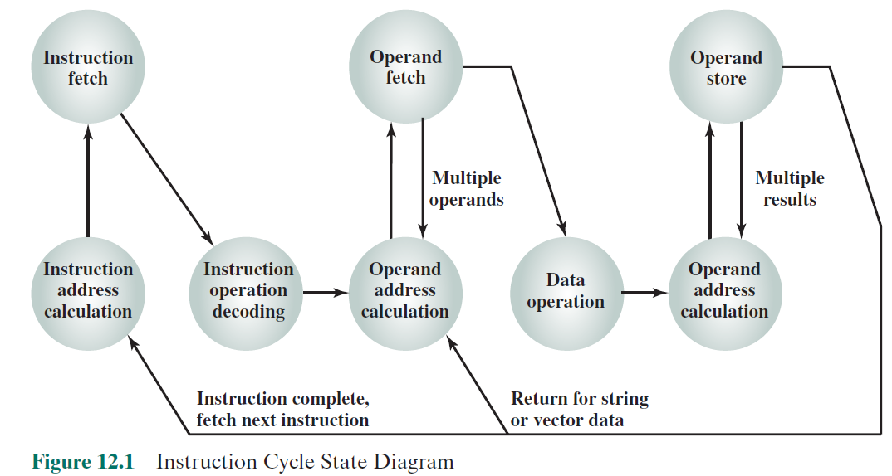
Instruction Cycle State Diagram
Notes:
3
Figure 12.1, which repeats Figure 3.6, shows the steps involved in instruction execution and, by implication, defines the elements of a machine instruction.
The address of the next instruction to be fetched could be either a real address or a virtual address, depending on the architecture. Generally, the distinction is transparent to the instruction set architecture. In most cases, the next instruction to be fetched immediately follows the current instruction. In those cases, there is no explicit reference to the next instruction. When an explicit reference is needed, then the main memory or virtual memory address must be supplied. The form in which that address is supplied is discussed in Chapter 13.

Slide 6
Source and result operands can be in one of four areas:
Processor register
A processor contains one or more registers that may be referenced by machine instructions.
If more than one register exists each register is assigned a unique name or number and the instruction must contain the number of the desired register
Main or virtual memory
As with next instruction references, the main or virtual memory address must be supplied
I/O device
The instruction must specify the I/O module and device for the operation. If memory-mapped I/O is used, this is just another main or virtual memory address
Immediate
The value of the operand is contained in a field in the instruction being executed
Notes:
4
Source and result operands can be in one of four areas:
Main or virtual memory: As with next instruction references, the main or virtual memory address must be supplied.
Processor register: With rare exceptions, a processor contains one or more registers that may be referenced by machine instructions. If only one register exists, reference to it may be implicit. If more than one register exists, then each register is assigned a unique name or number, and the instruction must contain the number of the desired register.
Immediate: The value of the operand is contained in a field in the instruction being executed.
I/O device: The instruction must specify the I/O module and device for the operation. If memory-mapped I/O is used, this is just another main or virtual memory address.

Slide 7
Instruction Representation
Within the computer each instruction is represented by a sequence of bits
The instruction is divided into fields, corresponding to the constituent elements of the instruction
Notes:
5
Within the computer, each instruction is represented by a sequence of bits. The instruction is divided into fields, corresponding to the constituent elements of the instruction.
A simple example of an instruction format is shown in Figure 12.2. As another example, the IAS instruction format is shown in Figure 2.2. With most instruction sets, more than one format is used. During instruction execution, an instruction is read into an instruction register (IR) in the processor. The processor must be able to extract the data from the various instruction fields to perform the required operation.
It is difficult for both the programmer and the reader of textbooks to deal with binary representations of machine instructions. Thus, it has become common practice to use a symbolic representation of machine instructions. An example of this was used for the IAS instruction set, in Table 1.1.

Slide 8

Instruction Representation
Opcodes are represented by abbreviations called mnemonics
Examples include:
ADD Add
SUB Subtract
MUL Multiply
DIV Divide
LOAD Load data from memory
STOR Store data to memory
Operands are also represented symbolically
Each symbolic opcode has a fixed binary representation
The programmer specifies the location of each symbolic operand
Notes:
5
Opcodes are represented by abbreviations, called mnemonics, that indicate
the operation. Common examples include
ADD Add
SUB Subtract
MUL Multiply
DIV Divide
LOAD Load data from memory
STOR Store data to memory
Operands are also represented symbolically. For example, the instruction
ADD R, Y may mean add the value contained in data location Y to the contents of register
R. In this example, Y refers to the address of a location in memory, and R refers
to a particular register. Note that the operation is performed on the contents of a
location, not on its address.
Thus, it is possible to write a machine-language program in symbolic form.
Each symbolic opcode has a fixed binary representation, and the programmer specifies
the location of each symbolic operand. For example, the programmer might
begin with a list of definitions:
X = 513
Y = 514
and so on. A simple program would accept this symbolic input, convert opcodes and
operand references to binary form, and construct binary machine instructions.
Machine-language programmers are rare to the point of nonexistence. Most
programs today are written in a high-level language or, failing that, assembly language,
which is discussed in Appendix B. However, symbolic machine language
remains a useful tool for describing machine instructions, and we will use it for that
purpose.

Slide 9
Instruction Types
Data processing
Arithmetic instructions provide computational capabilities for processing numeric data
Logic (Boolean) instructions operate on the bits of a word as bits rather than as numbers, thus they provide capabilities for processing any other type of data the user may wish to employ
Data storage
Movement of data into or out of register and or memory locations
Data movement
I/O instructions are needed to transfer programs and data into memory and the results of computations back out to the user
Control
Test instructions are used to test the value of a data word or the status of a computation
Branch instructions are used to branch to a different set of instructions depending on the decision made
Notes:
6
A computer should have a set of instructions that allows the user to formulate any data processing task. Another way to view it is to consider the capabilities of a high-level programming language. Any program written in a high-level language must be translated into machine language to be executed. Thus, the set of machine instructions must be sufficient to express any of the instructions from a high-level language. With this in mind we can categorize instruction types as follows:
Data processing: Arithmetic and logic instructions
Data storage: Movement of data into or out of register and or memory
locations
Data movement: I/O instructions
Control: Test and branch instructions
Arithmetic instructions provide computational capabilities for processing numeric data. Logic (Boolean) instructions operate on the bits of a word as bits rather than as numbers; thus, they provide capabilities for processing any other type of data the user may wish to employ. These operations are performed primarily on data in processor registers. Therefore, there must be memory instructions for moving data between memory and the registers. I/O instructions are needed to transfer programs and data into memory and the results of computations back out to the user. Test instructions are used to test the value of a data word or the status of a computation. Branch instructions are then used to branch to a different set of instructions depending on the decision made.

Slide 10
Write assembly code for
Y = (A – B)/[C + (D * E)].

Slide 11
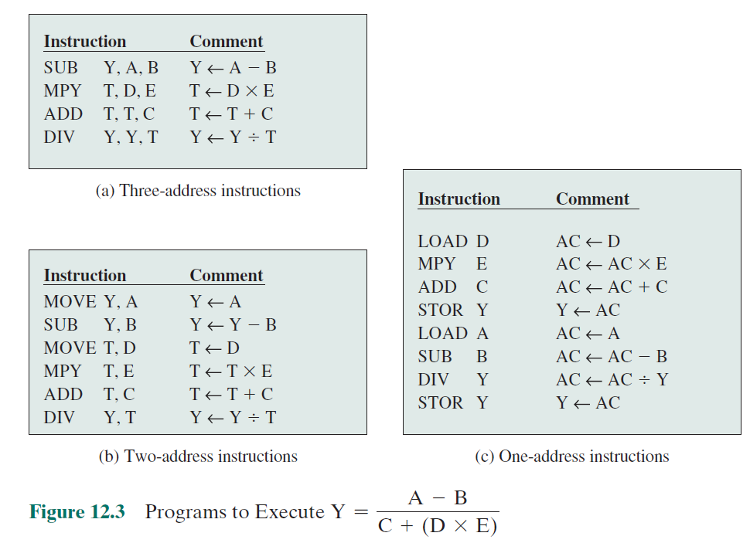
Notes:
7
One of the traditional ways of describing processor architecture is in terms of the
number of addresses contained in each instruction. This dimension has become less
significant with the increasing complexity of processor design. Nevertheless, it is useful
at this point to draw and analyze this distinction.
What is the maximum number of addresses one might need in an instruction?
Evidently, arithmetic and logic instructions will require the most operands.
Virtually all arithmetic and logic operations are either unary (one source
operand) or binary (two source operands). Thus, we would need a maximum of
two addresses to reference source operands. The result of an operation must be
stored, suggesting a third address, which defines a destination operand. Finally,
after completion of an instruction, the next instruction must be fetched, and its
address is needed.
This line of reasoning suggests that an instruction could plausibly be required
to contain four address references: two source operands, one destination operand,
and the address of the next instruction. In most architectures, many instructions
have one, two, or three operand addresses, with the address of the next instruction
being implicit (obtained from the program counter). Most architectures also have
a few special-purpose instructions with more operands. For example, the load and
store multiple instructions of the ARM architecture, described in Chapter 13, designate
up to 17 register operands in a single instruction.
Figure 12.3 compares typical one, two, and three address instructions that
could be used to compute Y = (A – B)/[C + (D * E)]. With three addresses, each instruction specifies two source operand locations and a destination operand location. Because we choose not to alter the value of any of the operand locations, a temporary location, T, is used to store some intermediate results. Note that there are four instructions and that the original expression had five operands.
Three-address instruction formats are not common because they require a relatively long instruction format to hold the three address references. With two- address instructions, and for binary operations, one address must do double duty as both an operand and a result. Thus, the instruction SUB Y, B carries out the calculation Y - B and stores the result in Y. The two-address format reduces the space requirement but also introduces some awkwardness. To avoid altering the value of an operand, a MOVE instruction is used to move one of the values to a result or temporary location before performing the operation. Our sample program expands to six instructions.
Simpler yet is the one-address instruction. For this to work, a second address must be implicit. This was common in earlier machines, with the implied address being a processor register known as the accumulator (AC). The accumulator contains one of the operands and is used to store the result. In our example, eight instructions are needed to accomplish the task.
It is, in fact, possible to make do with zero addresses for some instructions. Zero-address instructions are applicable to a special memory organization called a stack. A stack is a last-in-first-out set of locations. The stack is in a known location and, often, at least the top two elements are in processor registers. Thus, zero-address instructions would reference the top two stack elements. Stacks are described in Appendix I. Their use is explored further later in this chapter and in Chapter 13.

Slide 12
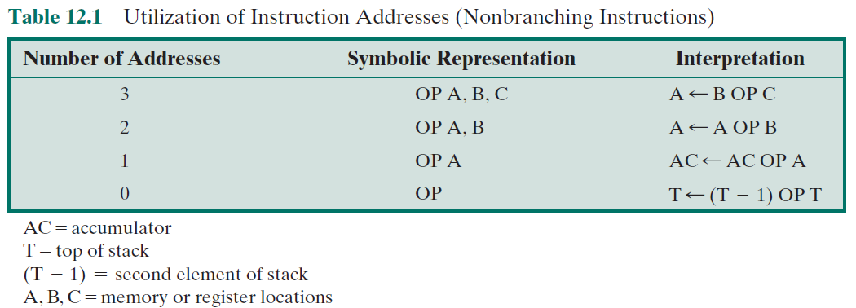
Zero-address instructions are applicable to a special memory organization called a stackA stack is a last-in-first-out set of locations. The stack is in a known location and, often, at least the top two elements are in processor registers. Thus, zero-address instructions would reference the top two stack elements
Notes:
8
Table 12.1 summarizes the interpretations to be placed on instructions with zero, one, two, or three addresses. In each case in the table, it is assumed that the address of the next instruction is implicit, and that one operation with two source operands and one result operand is to be performed.
The number of addresses per instruction is a basic design decision. Fewer addresses per instruction result in instructions that are more primitive, requiring a less complex processor. It also results in instructions of shorter length. On the other hand, programs contain more total instructions, which in general results in longer execution times and longer, more complex programs. Also, there is an important threshold between one-address and multiple-address instructions. With one-address instructions, the programmer generally has available only one general-purpose register, the accumulator. With multiple-address instructions, it is common to have multiple general-purpose registers. This allows some operations to be performed
solely on registers. Because register references are faster than memory references, this speeds up execution. For reasons of flexibility and ability to use multiple registers, most contemporary machines employ a mixture of two- and three-address instructions.
The design trade-offs involved in choosing the number of addresses per instruction are complicated by other factors. There is the issue of whether an address references a memory location or a register. Because there are fewer registers, fewer bits are needed for a register reference. Also, as we shall see in Chapter 13, a machine may offer a variety of addressing modes, and the specification of mode takes one or more bits. The result is that most processor designs involve a variety of instruction formats.

Slide 13
Number of Addresses
3 addresses
Operand 1, Operand 2, Result
a = b + c;
May be a fourth - next instruction (usually implicit)
Needs very long words to hold everything

Slide 14
Number of Addresses
2 addresses
One address doubles as operand and result
a = a + b
Reduces length of instruction
Common format in most architectures
Requires some extra work
Temporary storage to hold some results

Slide 15
Number of Addresses
1 address
Implicit second address
Usually a register (accumulator)
Common on early machines

Slide 16
Number of Addresses
0 (zero) addresses
All addresses implicit
Uses a stack
e.g. push a
push b
add
pop c
c = a + b

Slide 17
Instruction Addresses
The number of addresses per instruction is a basic design decision.
Fewer addresses per instruction:
less complex processor.
instructions of shorter length.
programs contain more total instructions
results in longer execution times and
longer, more complex programs.

Slide 18
Instruction Addresses
Also, there is an important threshold between one-address and multiple-address instructions.
With one-address instructions, the programmer generally has available only one general-purpose register, the accumulator.
With multiple-address instructions, it is common to have multiple general-purpose registers.
This allows some operations to be performed solely on registers.
Because register references are faster than memory references, this speeds up execution.
For reasons of flexibility and ability to use multiple registers, most contemporary machines employ a mixture of two- and three-address instructions.

Slide 19
Instruction Set Design
Very complex because it affects so many aspects of the computer system
Defines many of the functions performed by the processor
Programmer’s means of controlling the processor
Fundamental design issues:
Operation repertoire
How many and which operations to provide and how complex operations should be
Data types
The various types of data upon which operations are performed
Instruction format
Instruction length in bits, number of addresses, size of various fields, etc.
Registers
Number of processor registers that can be referenced by instructions and their use
Addressing
The mode or modes by which the address of an operand is specified
Notes:
9
One of the most interesting, and most analyzed, aspects of computer design is instruction set design. The design of an instruction set is very complex because it affects so many aspects of the computer system. The instruction set defines many of the functions performed by the processor and thus has a significant effect on the implementation of the processor. The instruction set is the programmer’s means of controlling the processor. Thus, programmer requirements must be considered in designing the instruction set.
It may surprise you to know that some of the most fundamental issues relating to the design of instruction sets remain in dispute. Indeed, in recent years, the level of disagreement concerning these fundamentals has actually grown. The most important of these fundamental design issues include the following:
Operation repertoire: How many and which operations to provide, and how complex operations should be
Data types: The various types of data upon which operations are performed
Instruction format: Instruction length (in bits), number of addresses, size of
various fields, and so on
Registers: Number of processor registers that can be referenced by instructions, and their use
Addressing: The mode or modes by which the address of an operand is specified
These issues are highly interrelated and must be considered together in designing an instruction set. This book, of course, must consider them in some sequence, but an attempt is made to show the interrelationships.
Because of the importance of this topic, much of Part Three is devoted to
instruction set design. Following this overview section, this chapter examines data
types and operation repertoire. Chapter 13 examines addressing modes (which
includes a consideration of registers) and instruction formats. Chapter 15 examines
the reduced instruction set computer (RISC). RISC architecture calls into question
many of the instruction set design decisions traditionally made in commercial
computers.

Slide 20
Fundamental Design Issues
Operation repertoire
How many and which operations to provide, and how complex operations should be
Data types
The various types of data upon which operations are performed
Instruction format
Instruction length (in bits), number of addresses, size of various fields, and so on
Registers
Number of processor registers that can be referenced by instructions, and their use
Addressing
The mode or modes by which the address of an operand is specified

Slide 21
Types of Operands
Addresses
Numbers Integers, floating point
Characters ASCII
Logical Data Bits or flags
Notes:
14
Machine instructions operate on data. The most important general categories of data are
Addresses
Numbers
Characters
Logical data
We shall see, in discussing addressing modes in Chapter 13, that addresses are, in fact, a form of data. In many cases, some calculation must be performed on the operand reference in an instruction to determine the main or virtual memory address. In this context, addresses can be considered to be unsigned integers.
Other common data types are numbers, characters, and logical data, and each of these is briefly examined in this section. Beyond that, some machines define specialized data types or data structures. For example, there may be machine operations that operate directly on a list or a string of characters.

Slide 22
Types of Operations
Data transfer
Arithmetic
Logical
Conversion
I/O
System control
Transfer of control

Slide 23
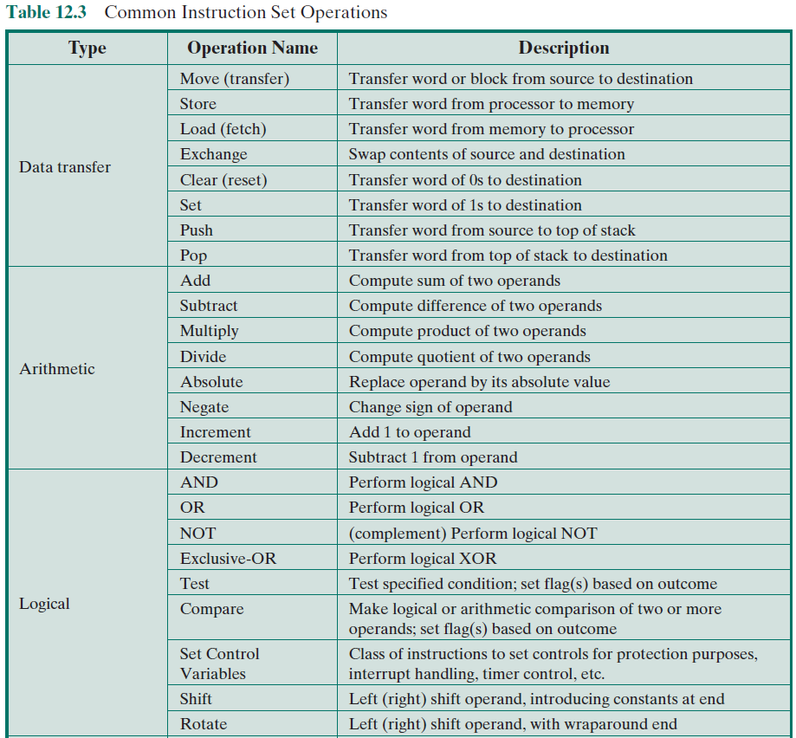
Notes:
18
The number of different opcodes varies widely from machine to machine. However, the same general types of operations are found on all machines. A useful and typical categorization is the following:
Data transfer
Arithmetic
Logical
Conversion
I/O
System control
Transfer of control
Table 12.3 (based on [HAYE98]) lists common instruction types in each category.

Slide 24
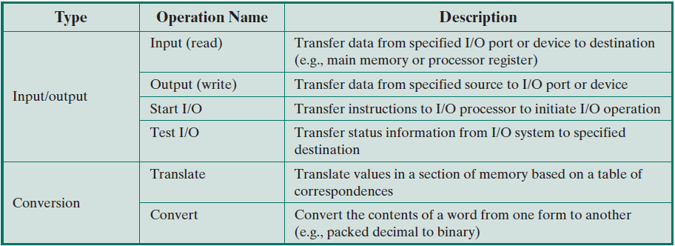
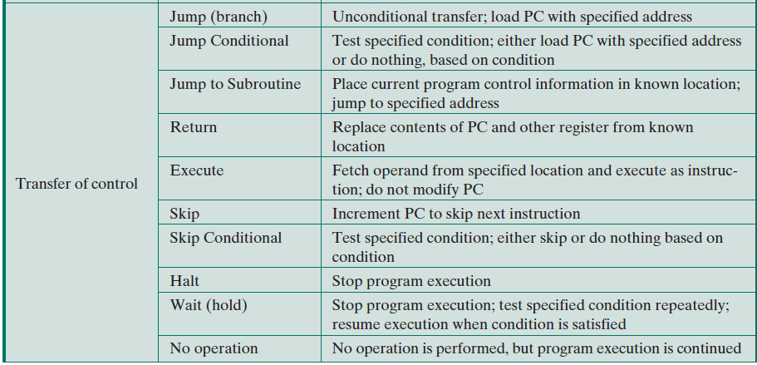

Slide 25
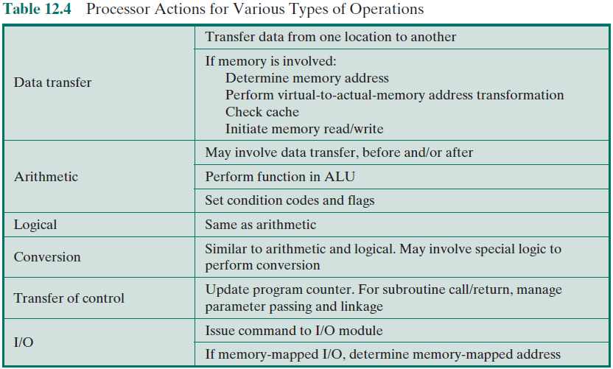
Processor Actions
Notes:
This section provides a brief survey of these various types of operations, together with a brief discussion of the actions taken by the processor to execute a particular type of operation (summarized in Table 12.4). The latter topic is examined in more detail in Chapter 14.

Slide 26

Data Transfer
Most fundamental type of machine instruction
Must specify:
Location of the source and destination operands
The length of data to be transferred must be indicated
The mode of addressing for each operand must be specified
Notes:
19
The most fundamental type of machine instruction is the data transfer instruction. The data transfer instruction must specify several things. First, the location of the source and destination operands must be specified. Each location could be memory, a register, or the top of the stack. Second, the length of data to be transferred must be indicated. Third, as with all instructions with operands, the mode of addressing for each operand must be specified. This latter point is discussed in Chapter 13.

Slide 27
Arithmetic
Add, Subtract, Multiply, Divide
Signed Integer
Floating point ?
May include
Increment (a++)
Decrement (a--)
Negate (-a)
Notes:
20
Most machines provide the basic arithmetic operations of add, subtract, multi- ply, and divide. These are invariably provided for signed integer (fixed-point) numbers. Often they are also provided for floating-point and packed decimal numbers.
Other possible operations include a variety of single-operand instructions; for example,
• Absolute: Take the absolute value of the operand.
• Negate: Negate the operand.
• Increment: Add 1 to the operand.
• Decrement: Subtract 1 from the operand.
The execution of an arithmetic instruction may involve data transfer operations to position operands for input to the ALU, and to deliver the output of the ALU. Figure 3.5 illustrates the movements involved in both data transfer and arithmetic operations. In addition, of course, the ALU portion of the processor performs the desired operation.

Slide 28
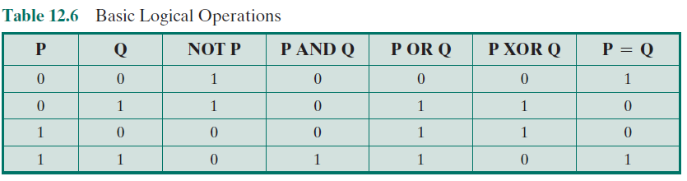
Logical
Notes:
21
Most machines also provide a variety of operations for manipulating individual bits of a word or other addressable units, often referred to as “bit twiddling.” They are based upon Boolean operations (see Chapter 11).
Some of the basic logical operations that can be performed on Boolean or binary data are shown in Table 12.6. The NOT operation inverts a bit. AND, OR, and Exclusive-OR (XOR) are the most common logical functions with two operands. EQUAL is a useful binary test.

Slide 29
Conversion
Instructions that change the format or operate on the format of data
An example is converting from decimal to binary
An example of a more complex editing instruction is the EAS/390 Translate (TR) instruction
Notes:
22
Conversion instructions are those that change the format or operate on the format of data. An example is converting from decimal to binary. An example of a more complex editing instruction is the EAS/390 Translate (TR) instruction. This instruction can be used to convert from one 8-bit code to another, and it takes three operands:
TR R1 (L), R2
The operand R2 contains the address of the start of a table of 8-bit codes. The L bytes starting at the address specified in R1 are translated, each byte being replaced by the contents of a table entry indexed by that byte. For example, to translate from EBCDIC to IRA, we first create a 256-byte table in storage locations, say, 1000-10FF hexadecimal. The table contains the characters of the IRA code in the sequence of the binary representation of the EBCDIC code; that is, the IRA code is placed in the table at the relative location equal to the binary value of the EBCDIC code of the same character. Thus, locations 10F0 through 10F9 will contain the values 30 through 39, because F0 is the EBCDIC code for the digit 0, and 30 is the IRA code for the digit 0, and so on through digit 9. Now suppose we have the EBCDIC for the digits 1984 starting at location 2100 and we wish to trans- late to IRA. Assume the following:
• Locations 2100–2103 contain F1 F9 F8 F4.
• R1 contains 2100.
• R2 contains 1000.
Then, if we execute
TR R1 (4), R2
locations 2100–2103 will contain 31 39 38 34.

Slide 30
Input/Output
Variety of approaches taken:
Isolated programmed I/O
Memory-mapped programmed I/O
DMA
Use of an I/O processor
Many implementations provide only a few I/O instructions, with the specific actions specified by parameters, codes, or command words
Notes:
23
Input/output instructions were discussed in some detail in Chapter 7. As we saw, there are a variety of approaches taken, including isolated programmed I/O, memory-mapped programmed I/O, DMA, and the use of an I/O processor. Many implementations provide only a few I/O instructions, with the specific actions specified by parameters, codes, or command words.

Slide 31
System Control
Instructions that can be executed only while the processor is in a certain privileged state or is executing a program in a special privileged area of memory
Typically these instructions are reserved for the use of the operating system
Examples of system control operations:
A system control instruction may read or alter a control register
An instruction to read or modify a storage protection key
Access to process control blocks in a multiprogramming system
Notes:
24
System control instructions are those that can be executed only while the processor is in a certain privileged state or is executing a program in a special privileged area of memory. Typically, these instructions are reserved for the use of the operating system.
Some examples of system control operations are as follows. A system control instruction may read or alter a control register; we discuss control registers in Chapter 14. Another example is an instruction to read or modify a storage protection key, such as is used in the EAS/390 memory system. Another example is access to process control blocks in a multiprogramming system.

Slide 32
Transfer of Control
Reasons why transfer-of-control operations are required:
It is essential to be able to execute each instruction more than once
Virtually all programs involve some decision making
It helps if there are mechanisms for breaking the task up into smaller pieces that can be worked on one at a time
Most common transfer-of-control operations found in instruction sets:
Branch
Skip
Procedure call
Notes:
25
For all of the operation types discussed so far, the next instruction to be performed is the one that immediately follows, in memory, the current instruction. However, a significant fraction of the instructions in any program have as their function changing the sequence of instruction execution. For these instructions, the operation per- formed by the processor is to update the program counter to contain the address of some instruction in memory.
There are a number of reasons why transfer-of-control operations are required. Among the most important are the following:
In the practical use of computers, it is essential to be able to execute each instruction more than once and perhaps many thousands of times. It may require thousands or perhaps millions of instructions to implement an application. This would be unthinkable if each instruction had to be written out separately. If a table or a list of items is to be processed, a program loop is needed. One sequence of instructions is executed repeatedly to process all the data.
Virtually all programs involve some decision making. We would like the computer to do one thing if one condition holds, and another thing if another condition holds. For example, a sequence of instructions computes the square root of a number. At the start of the sequence, the sign of the number is tested. If the number is negative, the computation is not performed, but an error condition is reported.
To compose correctly a large or even medium-size computer program is an exceedingly difficult task. It helps if there are mechanisms for breaking the task up into smaller pieces that can be worked on one at a time.

Slide 33
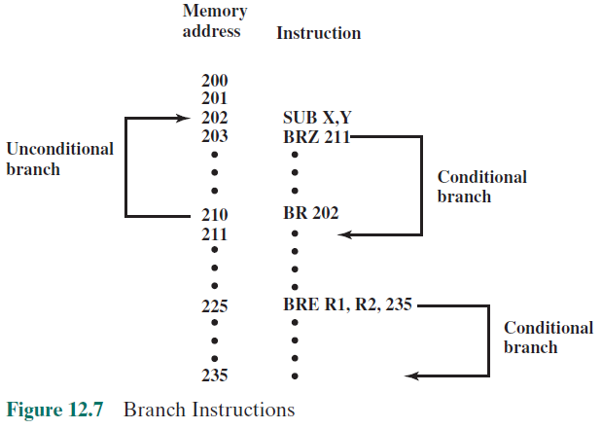
Transfer of Control (Branch Instructions)
Notes:
A branch instruction, also called a jump instruction, has as one of its operands the address of the next instruction to be executed. Most often, the instruction is a conditional branch instruction. That is, the branch is made (update program counter to equal address specified in operand) only if a certain condition is met. Otherwise, the next instruction in sequence is executed (increment program counter as usual). A branch instruction in which the branch is always taken is an unconditional branch.
There are two common ways of generating the condition to be tested in a conditional
branch instruction. First, most machines provide a 1-bit or multiple-bit condition
code that is set as the result of some operations. This code can be thought
of as a short user-visible register. As an example, an arithmetic operation (ADD,
SUBTRACT, and so on) could set a 2-bit condition code with one of the following
four values: 0, positive, negative, overflow. On such a machine, there could be four
different conditional branch instructions:
BRP X Branch to location X if result is positive.
BRN X Branch to location X if result is negative.
BRZ X Branch to location X if result is zero.
BRO X Branch to location X if overflow occurs.
In all of these cases, the result referred to is the result of the most recent operation
that set the condition code. Another approach that can be used with a three-
address instruction format is to perform a comparison and specify a branch in the same instruction. For example,
BRE R1, R2, X Branch to X if contents of R1 = contents of R2.
Figure 12.7 shows examples of these operations. Note that a branch can be either forward (an instruction with a higher address) or backward (lower address). The example shows how an unconditional and a conditional branch can be used to create a repeating loop of instructions. The instructions in locations 202 through 210 will be executed repeatedly until the result of subtracting Y from X is 0.

Slide 34
Transfer of Control (Skip Instructions)
Includes an implied address
Typically implies that one instruction be skipped, thus the implied address equals the address of the next instruction plus one instruction length
Because the skip instruction does not require a destination address field it is free to do other things
Example is the increment-and-skip-if-zero (ISZ) instruction
Notes:
Another form of transfer-of-control instruction is the skip instruction. The skip instruction includes an implied address. Typically, the skip implies that one instruction be skipped; thus, the implied address equals the address of the next instruction plus one instruction length.
Because the skip instruction does not require a destination address field, it is free to do other things. A typical example is the increment-and-skip-if-zero (ISZ) instruction.

Slide 35
Transfer of Control (Procedure Call Instructions)
Self-contained computer program that is incorporated into a larger program
At any point in the program the procedure may be invoked, or called
Processor is instructed to go and execute the entire procedure and then return to the point from which the call took place
Two principal reasons for use of procedures:
Economy
A procedure allows the same piece of code to be used many times
Modularity
Involves two basic instructions:
A call instruction that branches from the present location to the procedure
Return instruction that returns from the procedure to the place from which it was called
Notes:
Perhaps the most important innovation in the development of programming languages is the procedure. A procedure is a self- contained computer program that is incorporated into a larger program. At any point in the program the procedure may be invoked, or called. The processor is instructed to go and execute the entire procedure and then return to the point from which the call took place.
The two principal reasons for the use of procedures are economy and modularity. A procedure allows the same piece of code to be used many times. This is important for economy in programming effort and for making the most efficient use of storage space in the system (the program must be stored). Procedures also allow large programming tasks to be subdivided into smaller units. This use of modularity greatly eases the programming task.
The procedure mechanism involves two basic instructions: a call instruction that branches from the present location to the procedure, and a return instruction that returns from the procedure to the place from which it was called. Both of these are forms of branching instructions.

Slide 36
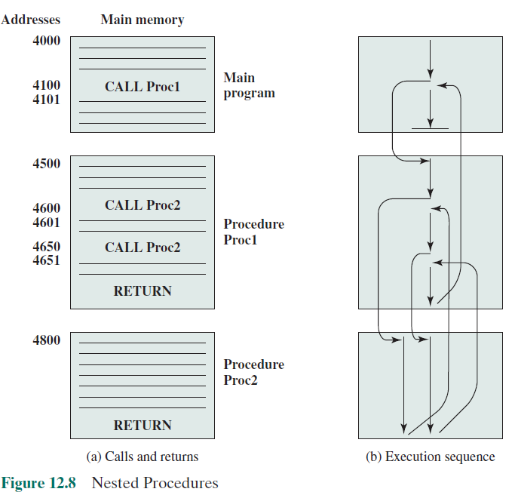
Notes:
Figure 12.8a illustrates the use of procedures to construct a program. In this example, there is a main program starting at location 4000. This program includes a call to procedure PROC1, starting at location 4500. When this call instruction is encountered, the processor suspends execution of the main program and begins execution of PROC1 by fetching the next instruction from location 4500. Within PROC1, there are two calls to PROC2 at location 4800. In each case, the execution of PROC1 is suspended and PROC2 is executed. The RETURN statement causes the processor to go back to the calling program and continue execution at the instruction after the corresponding CALL instruction. This behavior is illustrated in Figure 12.8b.
Three points are worth noting:
1. A procedure can be called from more than one location.
2. A procedure call can appear in a procedure. This allows the nesting of procedures to an arbitrary depth.
3. Each procedure call is matched by a return in the called program.
Because we would like to be able to call a procedure from a variety of points,
the processor must somehow save the return address so that the return can take
place appropriately. There are three common places for storing the return address:
■ Register
■ Start of called procedure
■ Top of stack
A reentrant procedure is one in which it is possible to have several calls open to it at
the same time. A recursive procedure (one that calls itself) is an example of the use
of this feature (see Appendix M). If parameters are passed via registers or memory
for a reentrant procedure, some code must be responsible for saving the parameters
so that the registers or memory space are available for other procedure calls.

Slide 37
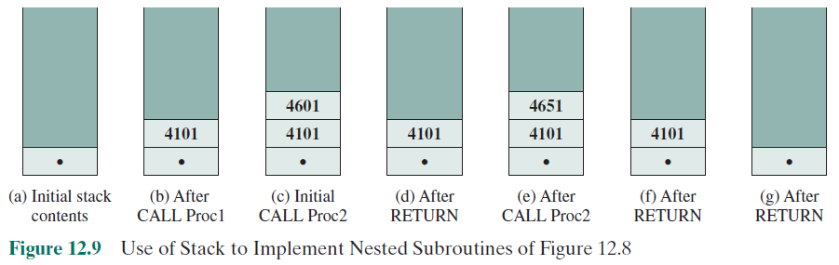
Transfer of Control (Procedure Call Instructions)
Notes:
A more general and powerful approach is to use a stack (see Appendix I for a discussion of stacks). When the processor executes a call, it places the return address on the stack. When it executes a return, it uses the address on the stack.
Figure 12.9 illustrates the use of the stack.
In addition to providing a return address, it is also often necessary to pass
parameters with a procedure call. These can be passed in registers. Another possibility
is to store the parameters in memory just after the CALL instruction. In this
case, the return must be to the location following the parameters. Again, both of
these approaches have drawbacks. If registers are used, the called program and the
calling program must be written to assure that the registers are used properly. The
storing of parameters in memory makes it difficult to exchange a variable number of
parameters. Both approaches prevent the use of reentrant procedures.

Slide 38
Summary
Instruction Sets:
Characteristics and Functions
Chapter 12
Machine instruction characteristics
Elements of a machine instruction
Instruction representation
Instruction types
Number of addresses
Instruction set design
Types of operands
Numbers
Characters
Logical data
Types of operations
Data transfer
Arithmetic
Logical
Conversion
Input/output
System control
Transfer of control
Notes:
Chapter 12 summary.

